Slide 1


NativeScript Kinvey PASOE
Lunch & Learn on how to create a mobile app using NativeScript w/ Kinvey BAAS and OpenEdge PASOE
Mauricio dos Santos
April 2019

Slide 2
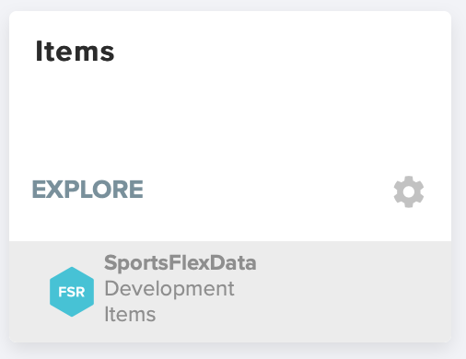
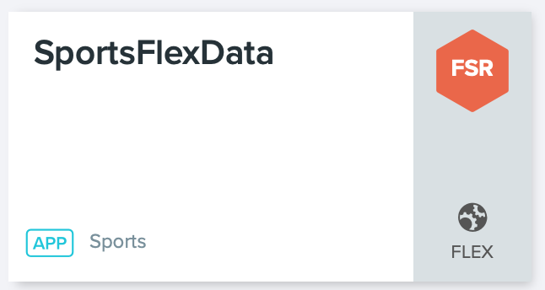
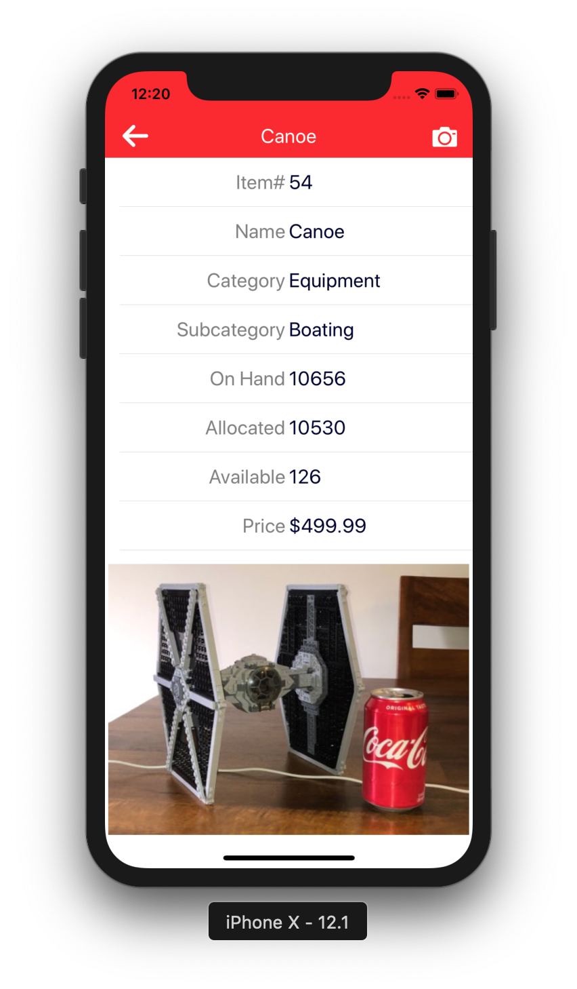
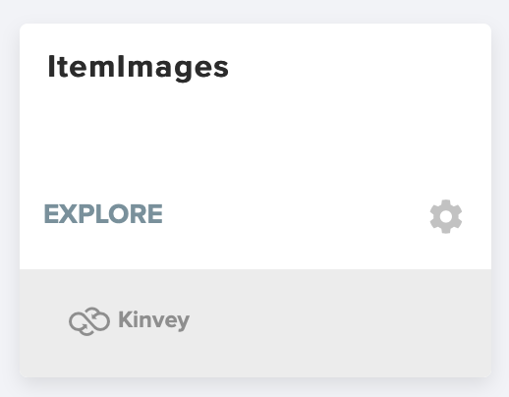
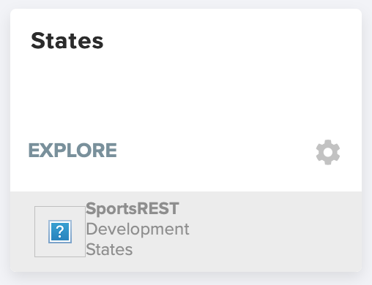
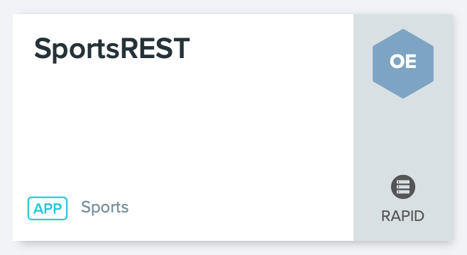
NativeScript Kinvey PASOE Architecture
NativeScript
Kinvey
PASOE
Kinvey SDK
Collections
Kinvey Flex (JSDO)
OpenEdge
Database
Kinvey Data Store
Kinvey RapidData ProgressData
OpenEdge
Database

Slide 3
NativeScript
Single source-code with tag based UI declaration and JavaScript, TypeScript, CSS, Vue and Angular
Renders native UI on iOS and Android
TypeScript + Angular provides OO and excellent binding
TypeScript is a typed superset of JavaScript
Angular lightweight framework provides a flexible structure including modularization, routing and data/event binding without enforcing MVC / no UI of its own
Microsoft Visual Studio Code (free) has TypeScript IntelliSence support and NativeScript includes the compiler nativescript-dev-typescript as a dev dependency

Slide 4
Kinvey
Backend as a service (BAAS), low-code, scalable etc.
MongoDB data collections (~tables) comprised of JSON-like documents (Kinvey entities — ~schema-less records or rows)
Kinvey’s own data stores are extremely efficient and ideal for mobile apps
RapidData connectors add CRUD support for external data
Flex Services created using node.js and can be used for almost anything (microservices)

Slide 5
PASOE
Running on Progress arcade AWS VM instance w/ basic AUTH
Simple Sports2000 database w/ updated dates (+20 years overall) but schema as-is
Business entities created using PDSOE w/ additional JFP logic from Progress community site
Avoid sorting issues: define temp-tables to be LIKE table + seq, id w/o redundant indexes: DEFINE TEMP-TABLE ttCustomer LIKE Customer BEFORE-TABLE bttCustomer FIELD id AS CHARACTER FIELD seq AS INTEGER INDEX seq seq.
Add lots of MESSAGE statements on CRUD and INVOKE methods to ensure everything works as you like (and sometimes expect)

Slide 6
Sports App
Plain NativeScript tags for UI w/ CSS and TypeScript / Angular
Uses kinvey-nativescript-sdk for CRUD operations and one custom endpoint to call specialized PASOE REST API (invoke) which returns complex dataset (3 temp-tables)
Connect to Kinvey using appKey and appSecret then login Kinvey’s app user
Kinvey’s FSR (flex service run-time) used for flex data (CRUD) and flex function (custom endpoint) all using JSDO
Flex service created as node project using kinvey-flex-sdk and deployed using Kinvey CLI

Slide 7
Sports App (demo)
Login using sales rep initials from sports database (both username and password, e.g. BBB/bbb)
App will show sales rep’s customers (filter capability)
Customers can be shown by number or name (sort capability)
loadMoreItems: auto paging scroll will fetch next 25 records when user reaches bottom (app wide limit prop)
App also shows and maintains customer orders and order lines (insert, update and delete via flex.) Camera plugin used to take picture to associate with an item (no flex.)

Slide 8
flex (how-to/demo)
Create flex service (FSR) within Kinvey’s app at console.kinvey.com
On your computer, install node, then Kinvey CLI, create profile, login
Create and initialize node app w/ node init then kinvey-flex-init
Install flex SDK w/ npm install kinvey-flex-sdk
Develop and test locally using node . and postman
When ready, upload to FSR using kinvey flex deploy
Check upload status with kinvey flex status
Back at console.kinvey.com, configure Kinvey app to use your flex service

Slide 9
References
Sports app: https://github.com/mdossant/Sports.git
NativeScript: https://nativescript.org
Kinvey: https://www.progress.com/kinvey
Kinvey console: https://console.kinvey.com
Mongo docs: https://docs.mongodb.com
How to add JFP support to a Business Entity: https://community.progress.com/community_groups/mobile/w/mobile/2933.how-to-add-jfp-support-to-a-business-entity

Slide 10
“simple not simpler”
–Albert Einstein

